Slide 1
CYBER RESILIENCE IN AVIATION
Radu Babiceanu, Anna Baron Garcia, Remzi Seker, Daniel Diessner, Carlos Castro
09/15/2022

Slide 2
Aviation Cybersecurity Challenges
Historically, security-by-obscurity
However, times changed…
  Wide availability of cyberattack tools
  Access to industry-specific knowledge
  Connectivity growth and software-driven functionality
  Computing services across all aviation ecosystem
Emphasize cyber-safety and continuity of systems’ operation
  Assess cyber threats according to their impact
  Pose system/component certification challenges

Slide 3
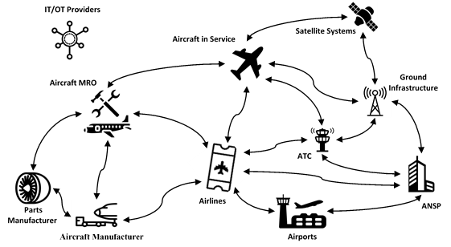
Aviation Ecosystem
Highly connected system-of-systems

Slide 4
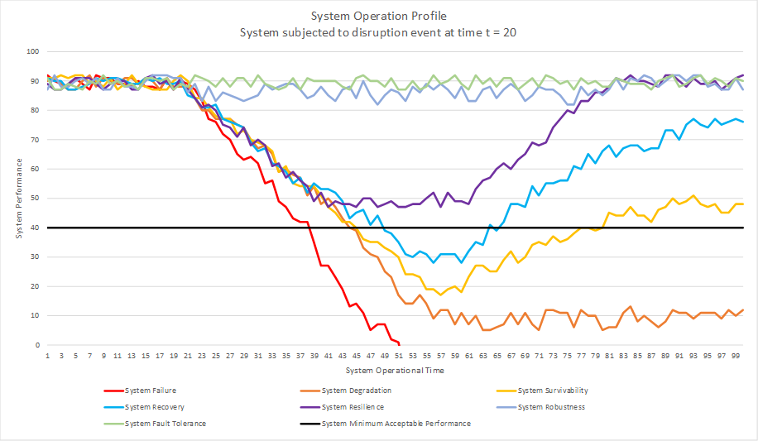
System Resilience
System must return to nominal performance timely

Slide 5
System Resilience
Organizational perspective (Deloitte survey 2021)
  Preparation
  Adaptation
  Collaboration
  Trustworthiness
  Responsibility
Resilient aviation ecosystem requires focus on all five
  Within organizations and across the ecosystem

Slide 6

Aviation Cyber Threats
Aircraft and component manufacturers
  Design, development, testing
Aircraft customization
  Run additional software
Airline services
  Frequent flyer, etc.
Airport exposure
  Aircraft and services

Slide 7
Aviation Cyber Threats
On-board systems
  EFB, FMS, avionics
Datalink communications
  Jamming, spoofing, interference, DOS
Satellite communications
  PNT services
Aircraft airport maintenance and MRO
  FLS, software updates
Aircraft retirement

Slide 8
Implementing Cyber Resilience
Government and industry
  FAA and EASA
  RTCA and EUROCAE
  SAE, ARINC, NIST, ISO
  FAA ASISP Working Group
  ACI
  A-ISAC
  ICAO
  TFSG

Slide 9
Implementing Cyber Resilience
Embry-Riddle Aeronautical University (ERAU)
  Aviation cybersecurity education
    Degree, certificate, training programs
  Aero-Cybersecurity Symposium
    Government, academic, industry cyber experts, civil and military

Slide 10
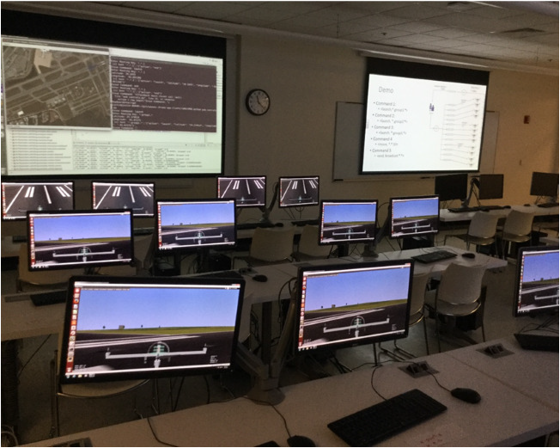
Implementing Cyber Resilience
Embry-Riddle Aeronautical University (ERAU)
  Aviation cybersecurity research
    Cyber-resilient avionics systems
    Aviation datalink security
    Formal modeling of combined safety / security
    Blockchain for MRO
    Aviation cybersecurity framework

Slide 11

Implementing Cyber Resilience
Embry-Riddle Aeronautical University (ERAU)
  Capture the Flag (CTF)
    A-ISAC
    DEFCON Aerospace Village
    AIAA Aviation Forum
    AIAA SCITECH Forum
    RSA Conference

Slide 12
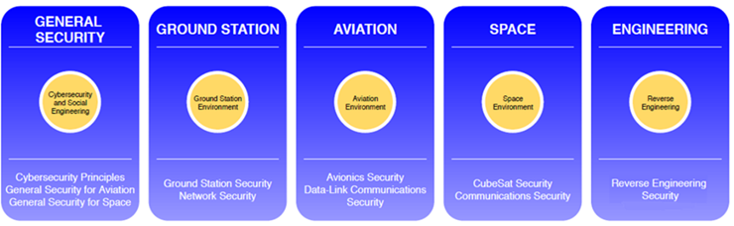
Implementing Cyber Resilience
Center for Aerospace Resilience (CAR)

Slide 13
Cyber Resilience… Journey Ahead…
Expand aviation cybersecurity education and training
Promote research to assure minimal impact on certification
Proactively address and mitigate threats
Employ complementary security methods
Leverage collective effort of all aviation ecosystem actors
Create resilience against both expected and unexpected risk

